Slide 1

HDS Tutorial 2 Week 4

Slide 2
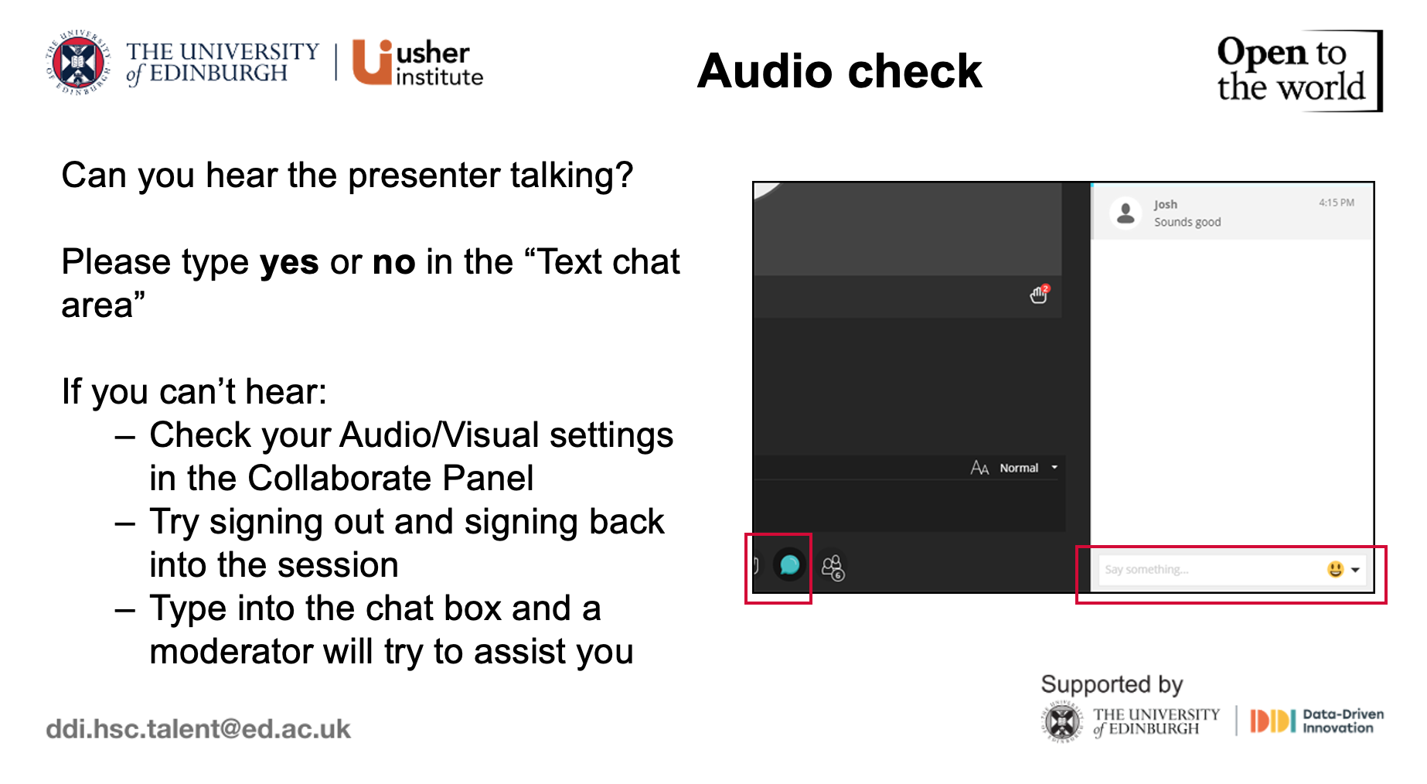

Slide 3


Slide 4
HDS Tutorial 2 Week 4

Slide 5

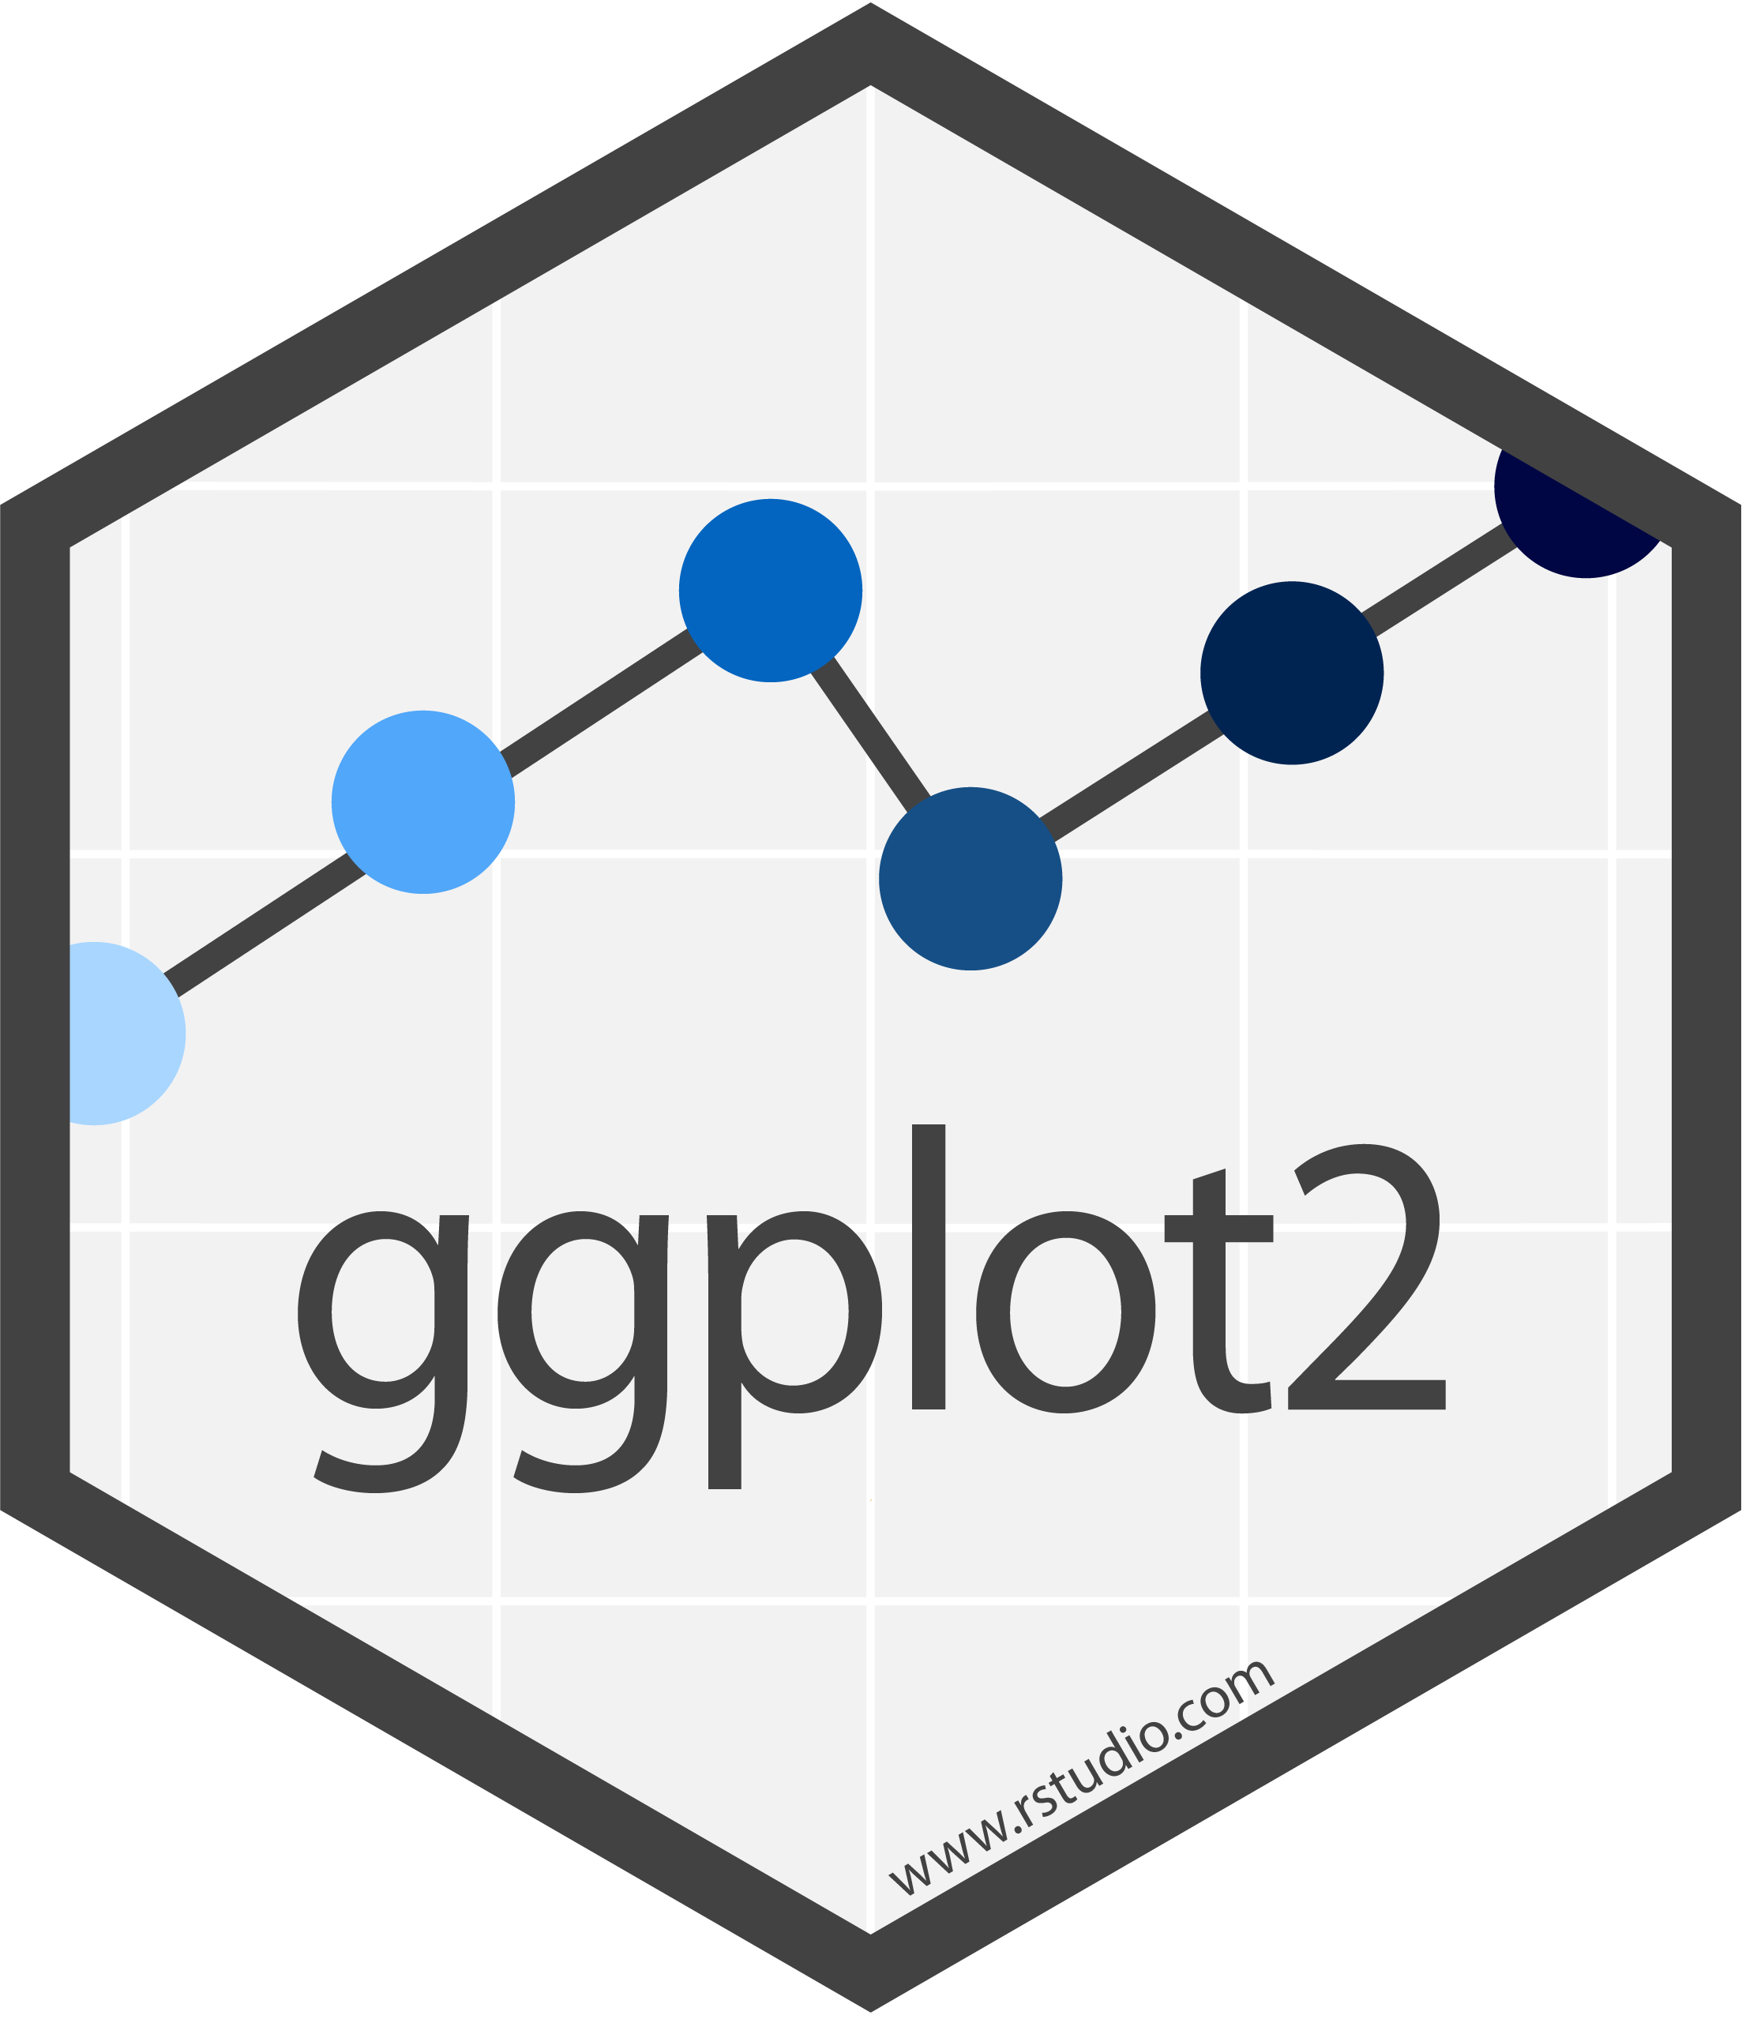

Agenda
Plots vs Tables
ggplot2 for making plots in R
Kable and KableExtra for making tables in R
Q&A

Slide 6
Are you using R on your own device, Noteable, or both?

Slide 7
Do you think figures or tables are more useful for data visualisation?

Slide 8
Why do graphs and tables matter?
Informative and well-presented graphs & tables ARE better communication
Both graphs AND tables are tools for communication

Slide 9
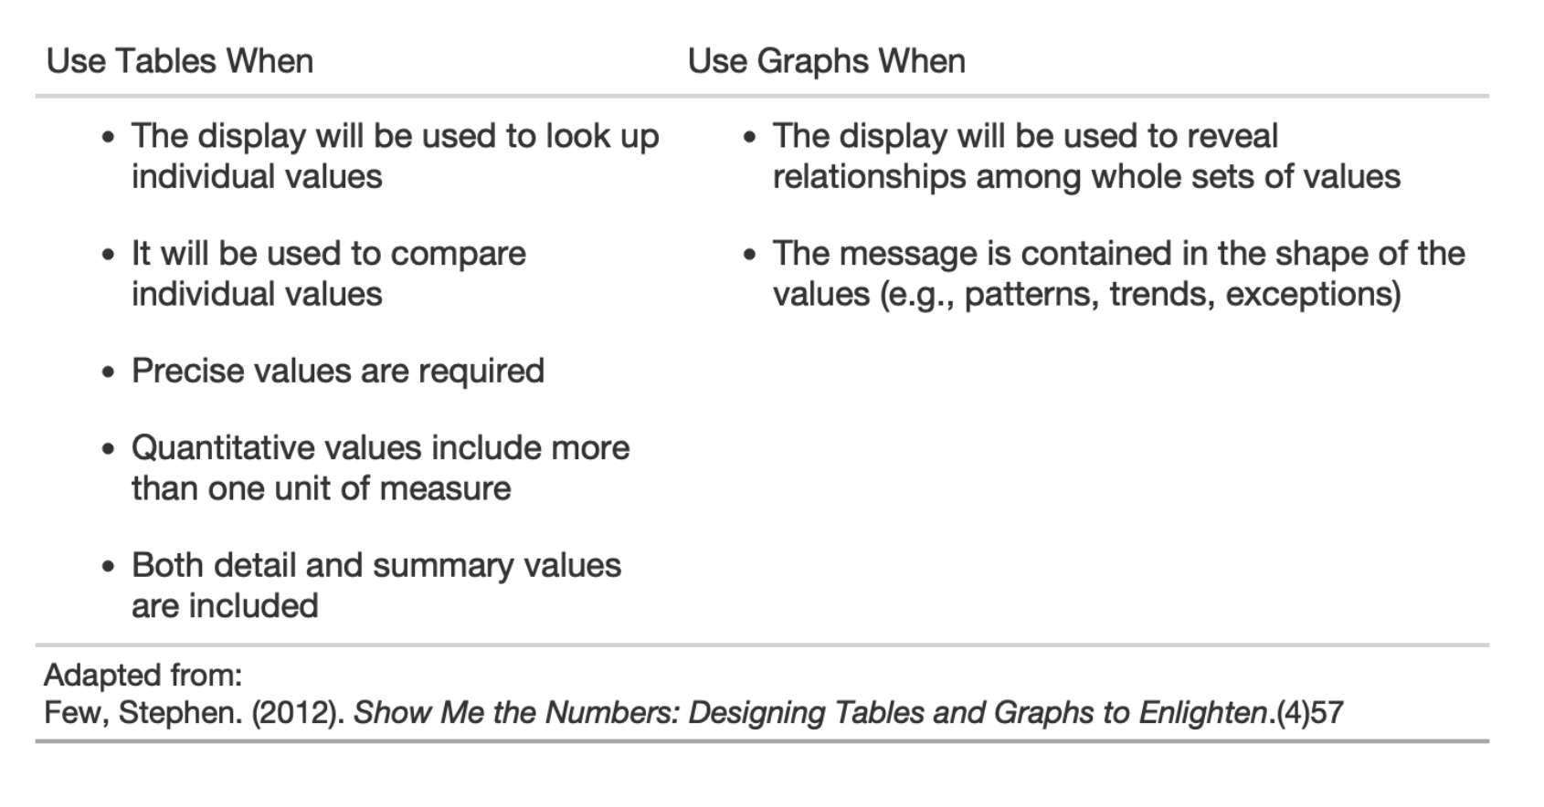
When to use tables vs graphs?

Slide 10
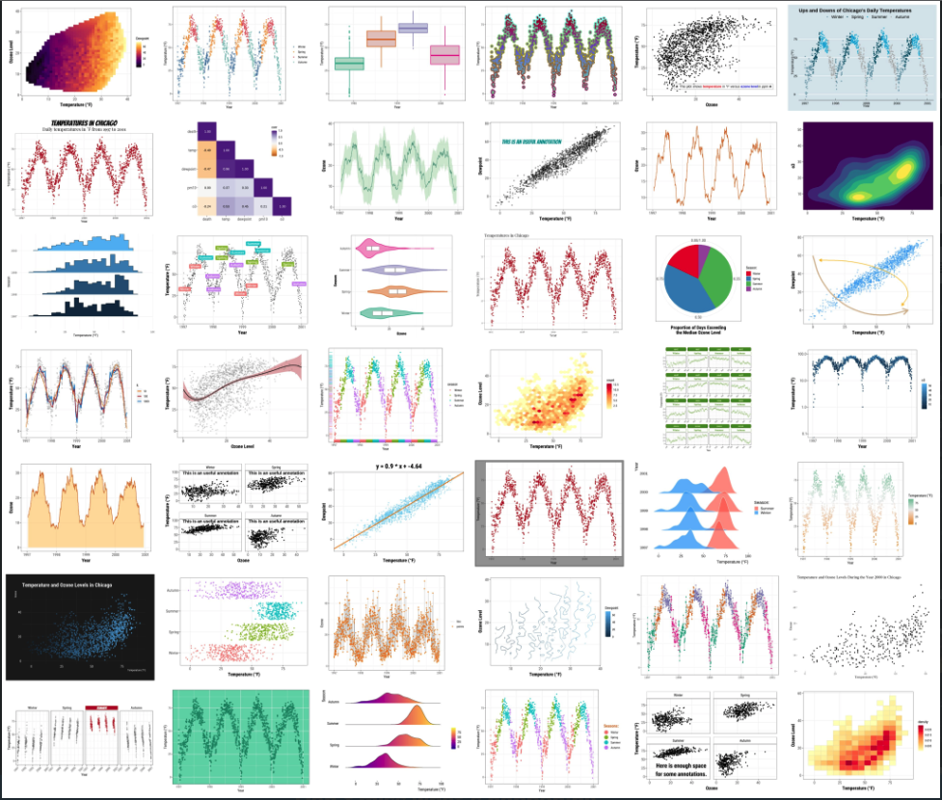
ggplot2
Application of Leland Wilkinson’s grammar of graphics for R
A system for iteratively and declaratively creating graphics
Just like grammar in a language constructs sentences, grammar of graphics constructs data visualisations
Credit: Cédric Sherer
ggplot2 in-depth tutorial

Slide 11
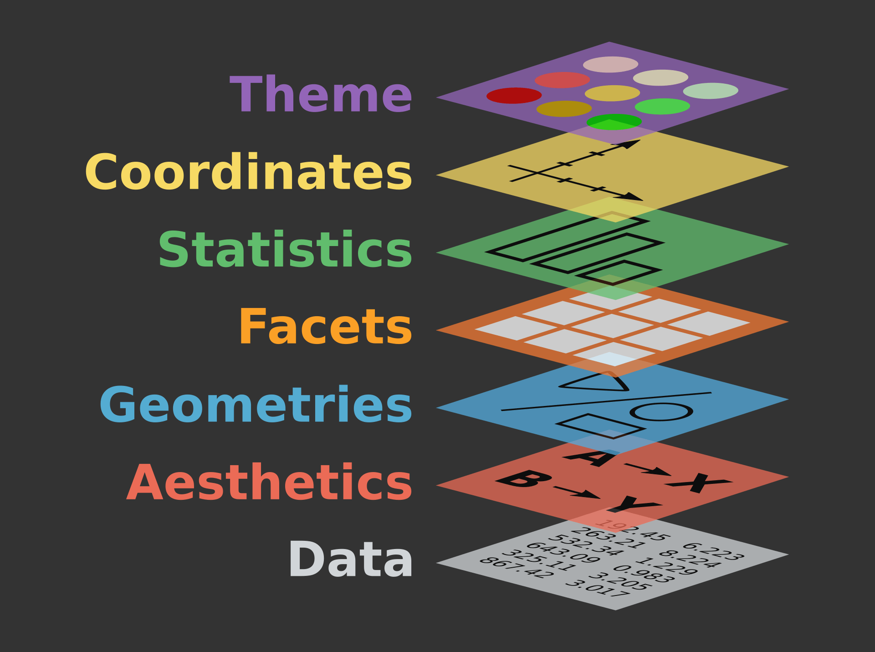
Building blocks of a ggplot
This layering is reflected in the code itself!
Element | Description | Code
Data | The dataset being plotted | ggplot(data = ,
Aesthetics | The scales onto which we map our data | aes(x, y, fill, color))
Geometries | The visual elements used for our data | + geom_()
Facets | Plotting small multiples | + facet_()
Statistics | Representations of our data to aid understanding | + stat_()
Coordinates | The space on which the data will be plotted | + coord_()
Themes | All non-data ink, design elements | + theme_()

Slide 12


The key ingredients
ggplot(data = cancelled ,
data layer use the data cancelled THEN

Slide 13
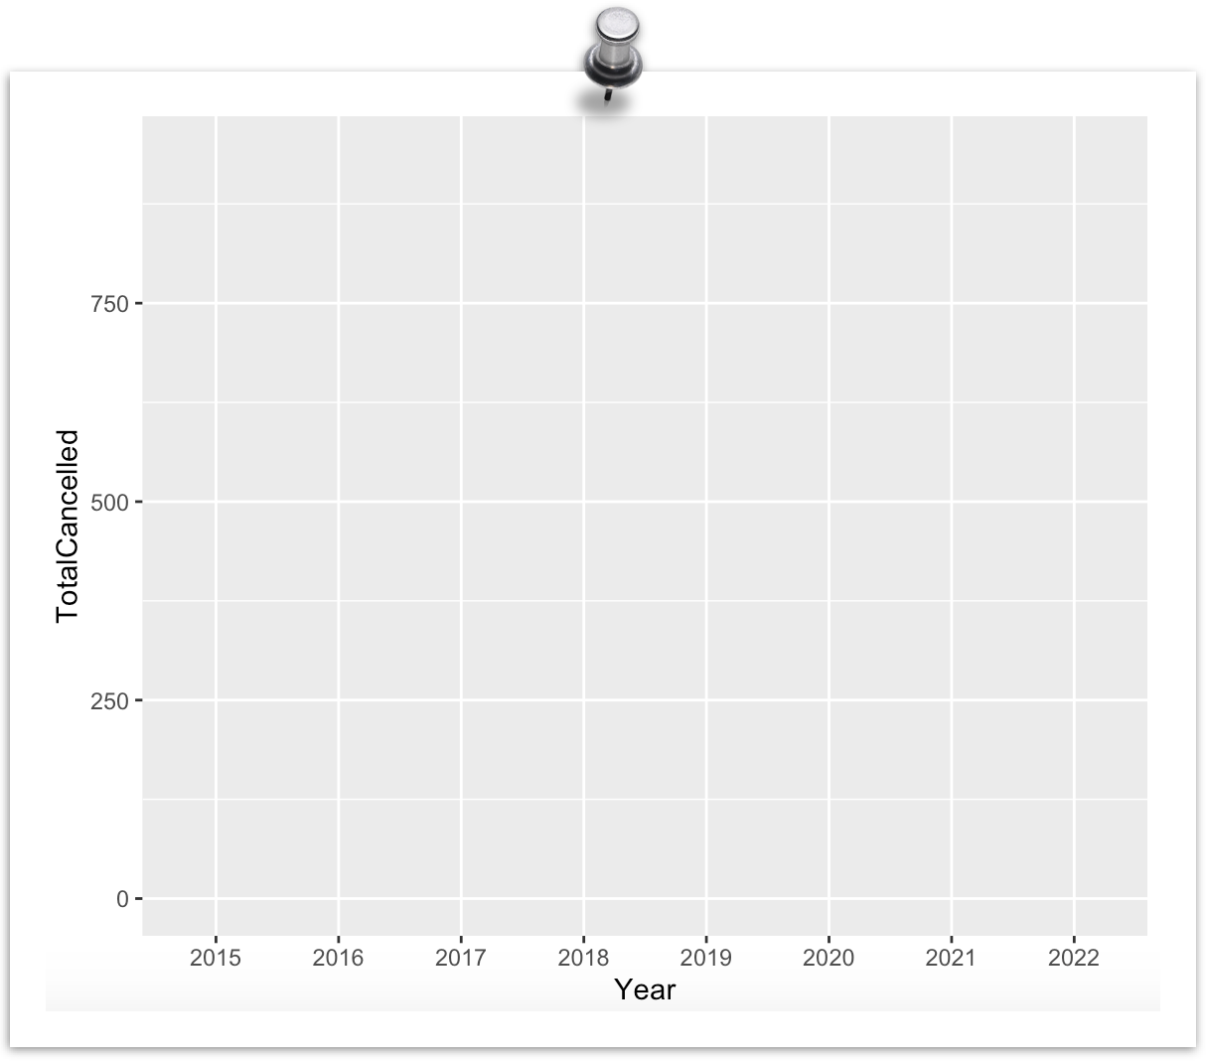

The key ingredients
ggplot(data = cancelled ,
data layer use the data cancelled THEN
aes(x = Year, y = TotalCancelled)) +
use the X axis to show “Year” then the Y axis to show ”Total Cancelled” AND
aesthetics layer

Slide 14
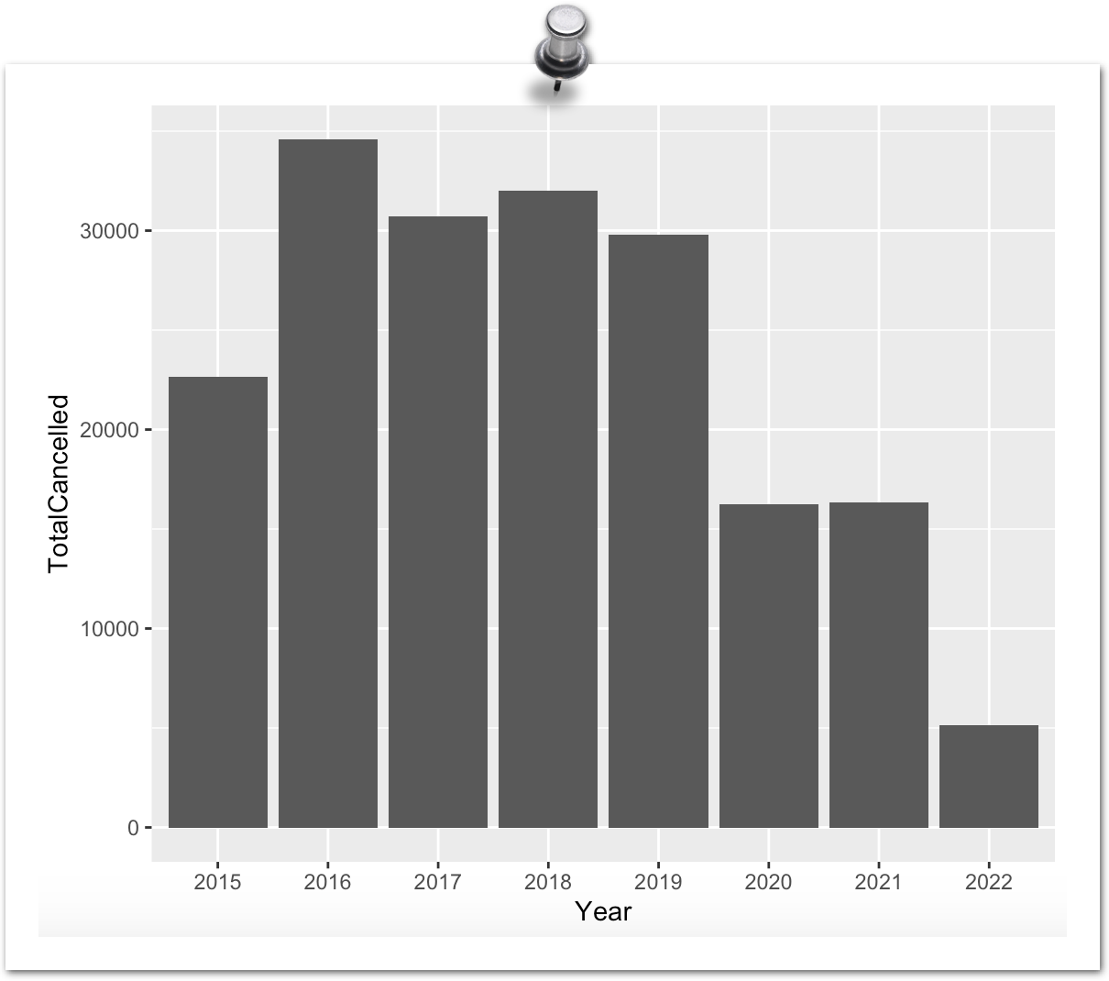
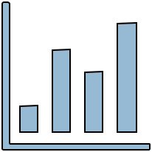
The key ingredients
ggplot(data = cancelled ,
data layer use the data cancelled THEN
aes(x = Year, y = TotalCancelled)) +
use the X axis to show “Year” then the Y axis to show ”Total Canceled” AND
aesthetics layer
geom_bar()
geometry layer …. take all that and make a bar chart

Slide 15
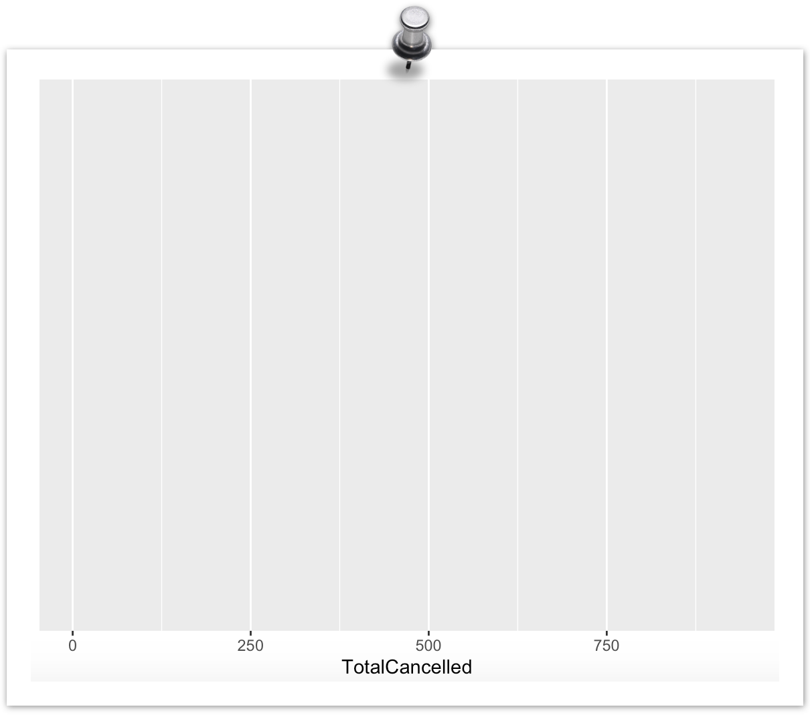
The key ingredients
ggplot(data = cancelled ,
data layer use the data cancelled THEN
aes(x = TotalCancelled)) +
use the X axis to show ”Total Cancelled” AND
aesthetics layer

Slide 16
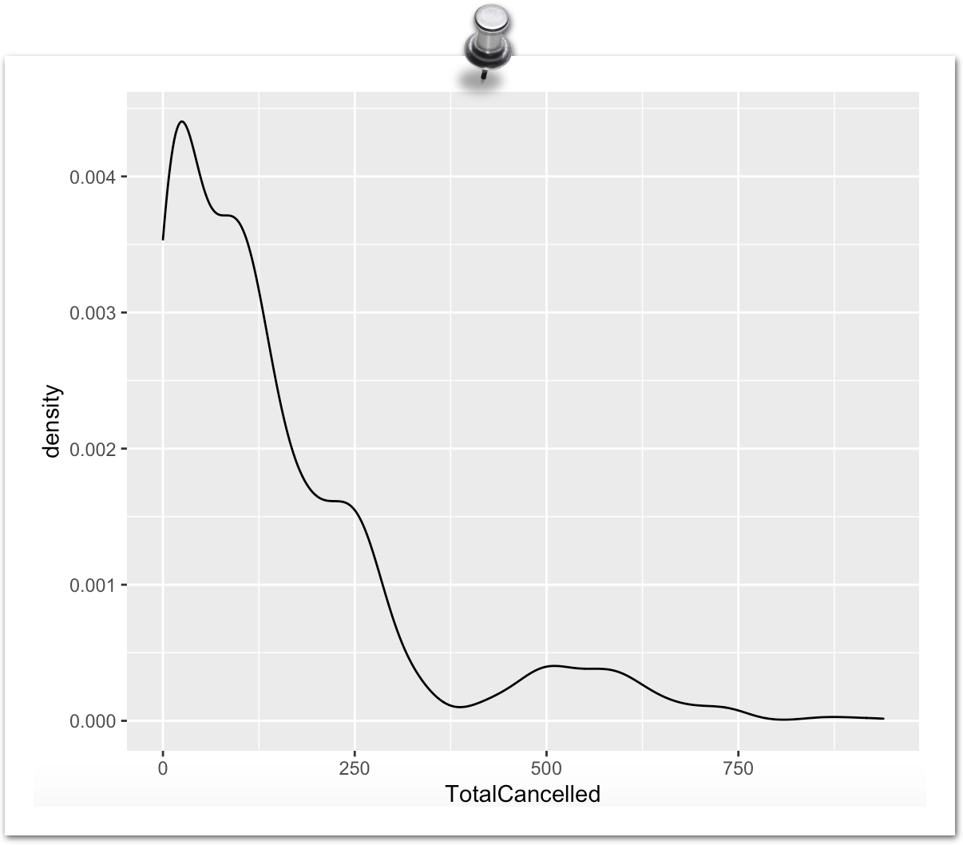
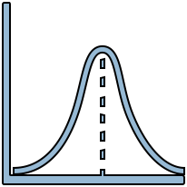
The key ingredients
ggplot(data = cancelled ,
data layer use the data cancelled THEN
aes(x = TotalCancelled)) +
use the X axis to show ”Total Cancelled” AND
aesthetics layer
geom_density()
geometry layer …. take all that and make a density chart

Slide 17
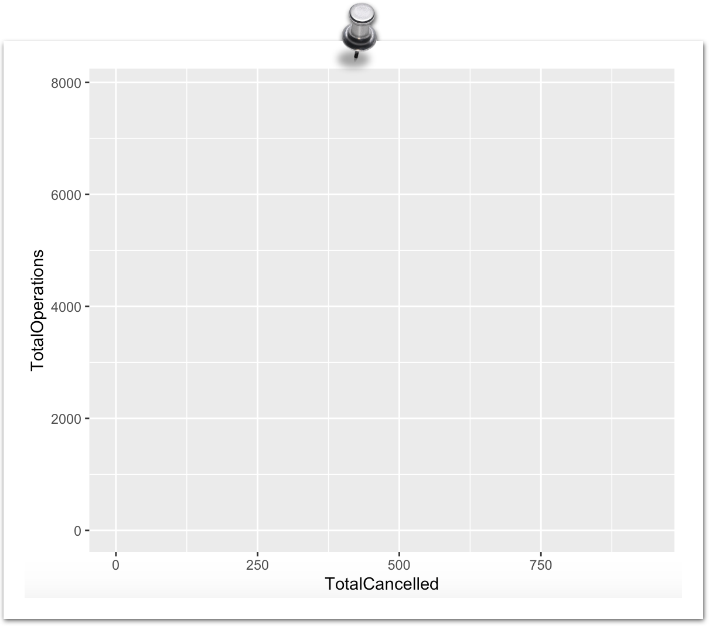
The key ingredients
ggplot(data = cancelled ,
data layer use the data cancelled THEN
aes(x = TotalCancelled, y = TotalOperations)) +
use the X axis to show “Total Cancelled” then the Y axis to show ”Total Operations” AND
aesthetics layer

Slide 18
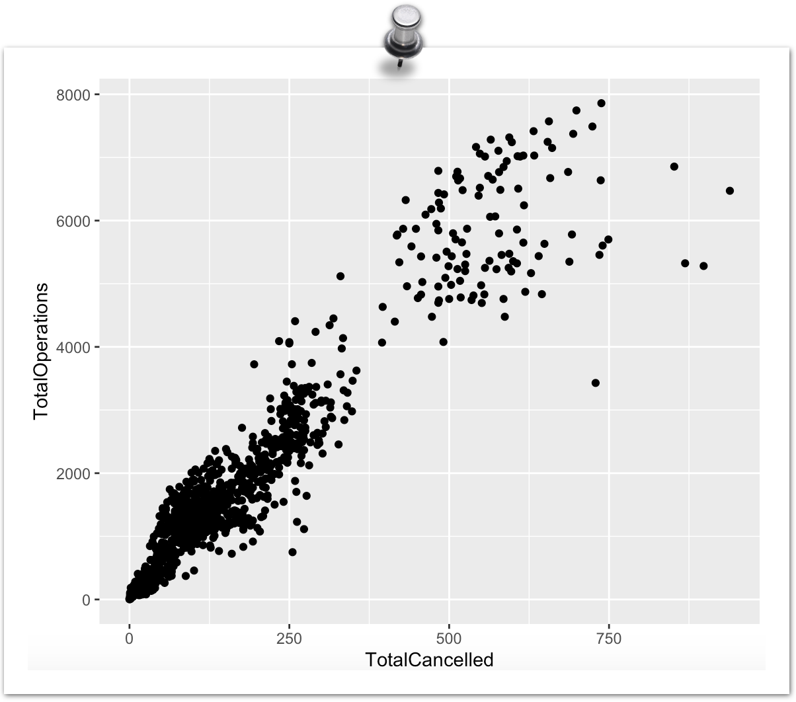
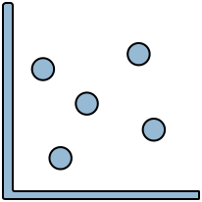
The key ingredients
ggplot(data = cancelled ,
data layer use the data cancelled THEN
aes(x = TotalCancelled, y = TotalOperations)) +
use the X axis to show “Total Cancelled” then the Y axis to show ”Total Operations” AND
aesthetics layer
geom_point()
geometry layer …. take all that and make a scatter plot

Slide 19
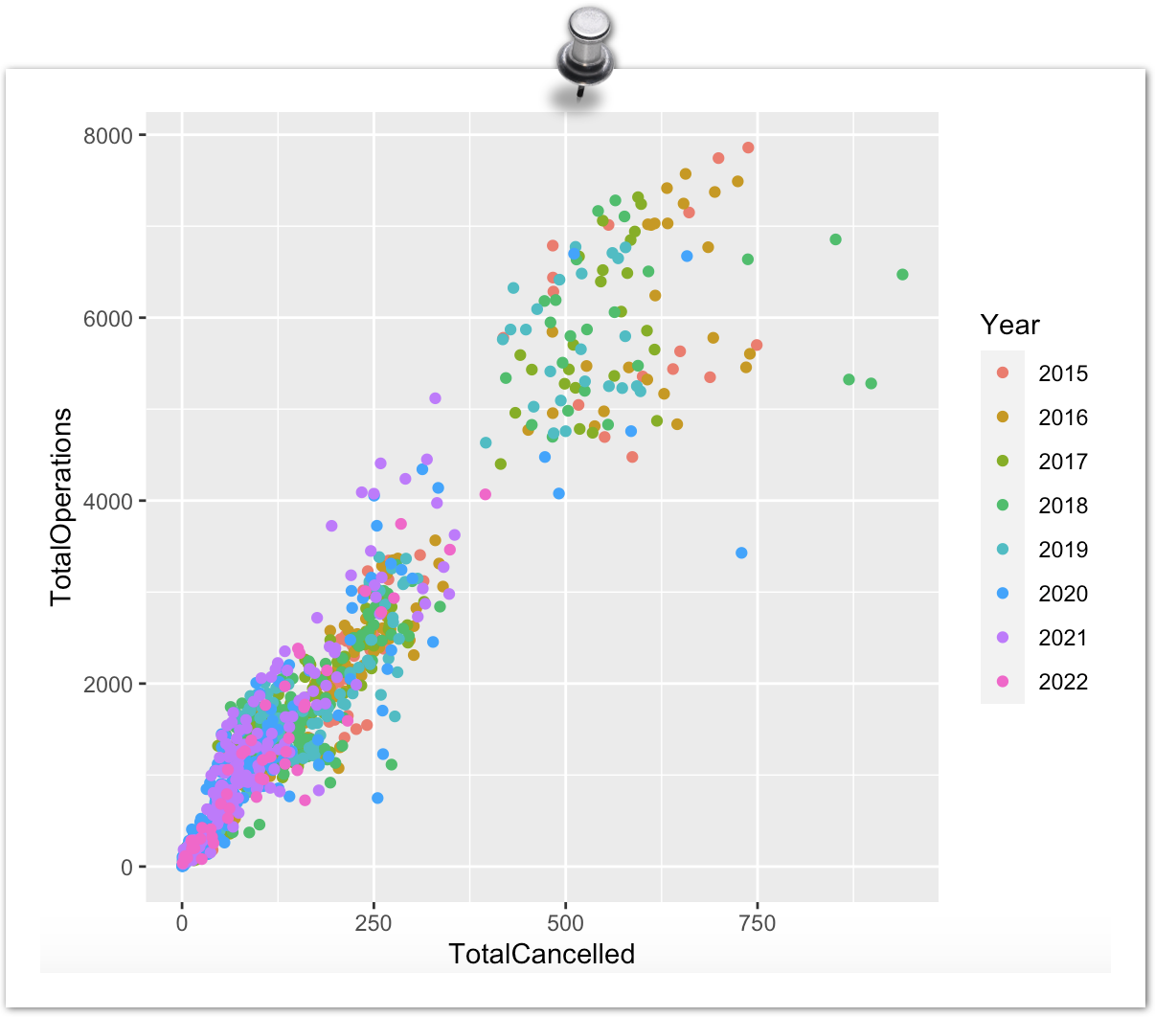
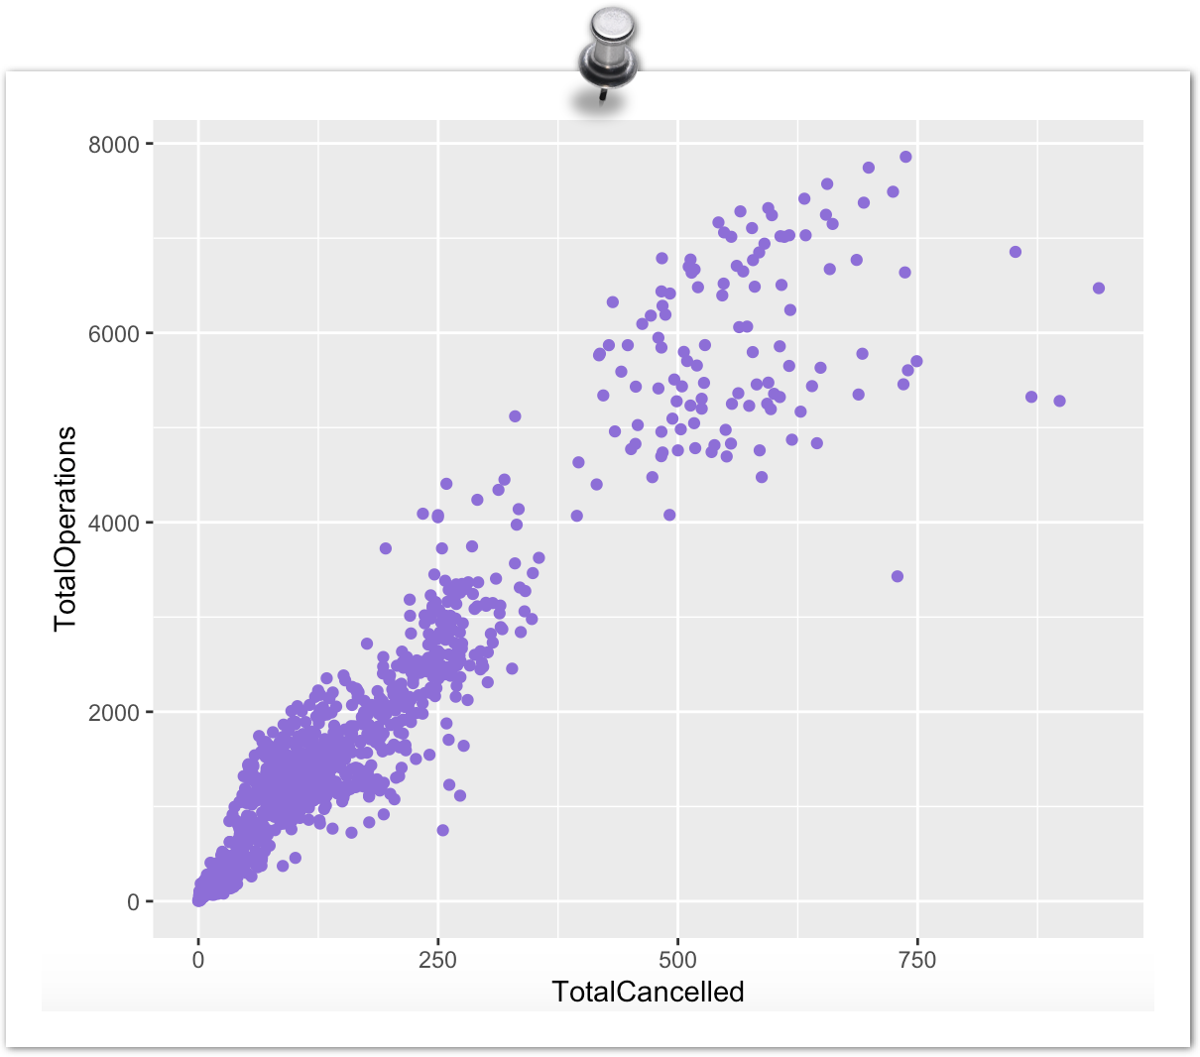
Aesthetics: Inside, Outside, or both
Within aes(): the argument changes based on the values of the variable
Outside aes(): the argument is given a single value and doesn't change based on the values of the variable

Slide 20
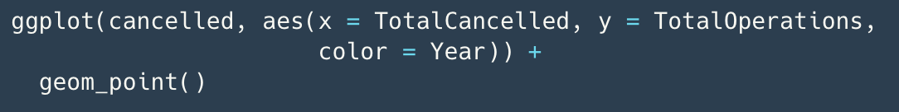
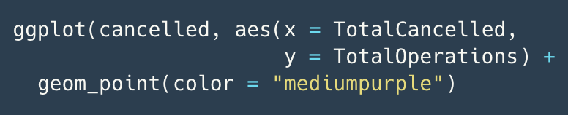
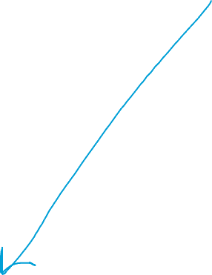


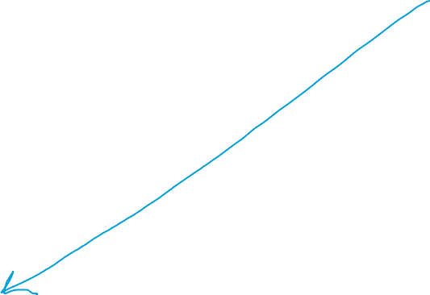
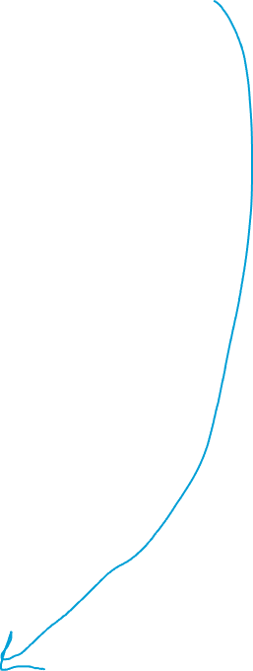
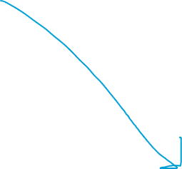
Aesthetics: Inside vs Outside

Slide 21
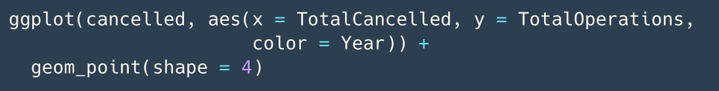
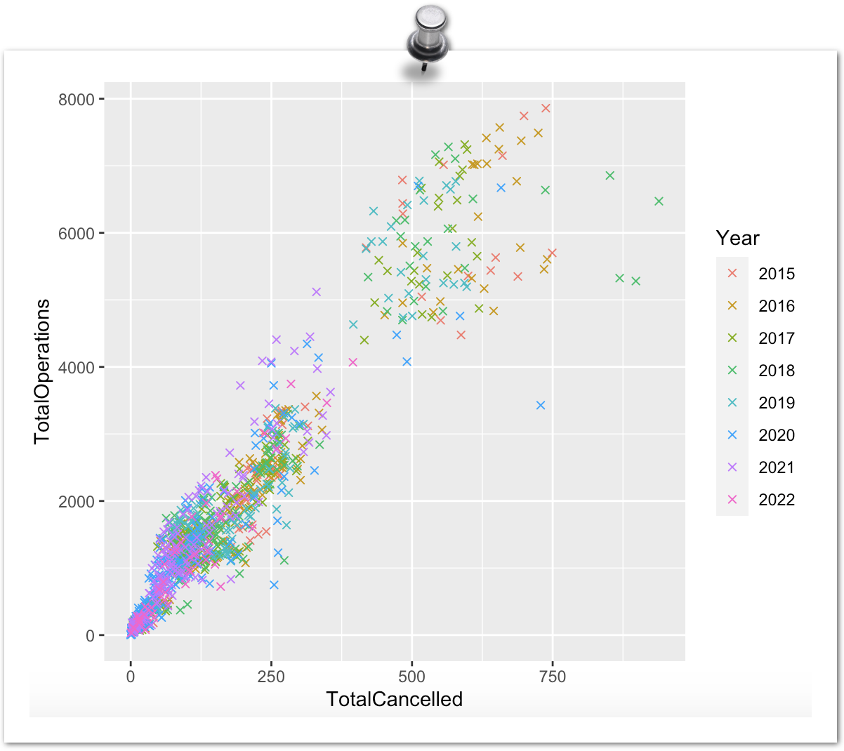

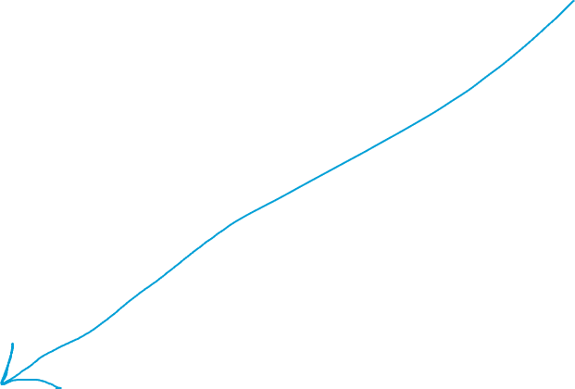
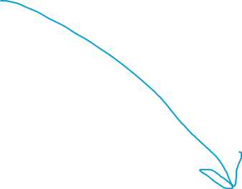
Aesthetics: Inside, Outside, or both
To learn more about the different aesthetic specifications
For a list of colors in R

Slide 22
Geoms: decisions, decisions
One variable
Two variables
Three + variables
How many variables?
What kind of variables?
Ordered: categories have a natural order (e.g., income brackets, age categories)
Categorical/Discrete:
Finite number of categories to which all observations belong (e.g., countries, age categories, diagnoses)
Unordered: categories do not have a natural order (e.g., eye colour, diagnoses)
Numeric/Continuous:
Theoretically infinite range of possible values (e.g., height, age, weight)

Slide 23
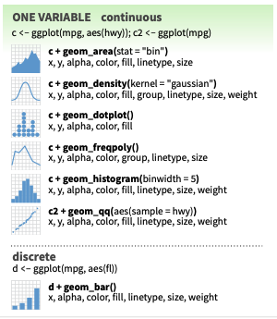
One variable geoms
Continuous/numeric X
Histogram
Density plot
Dot plot
Etc.
Discrete/Categorical X
Bar charts

Slide 24
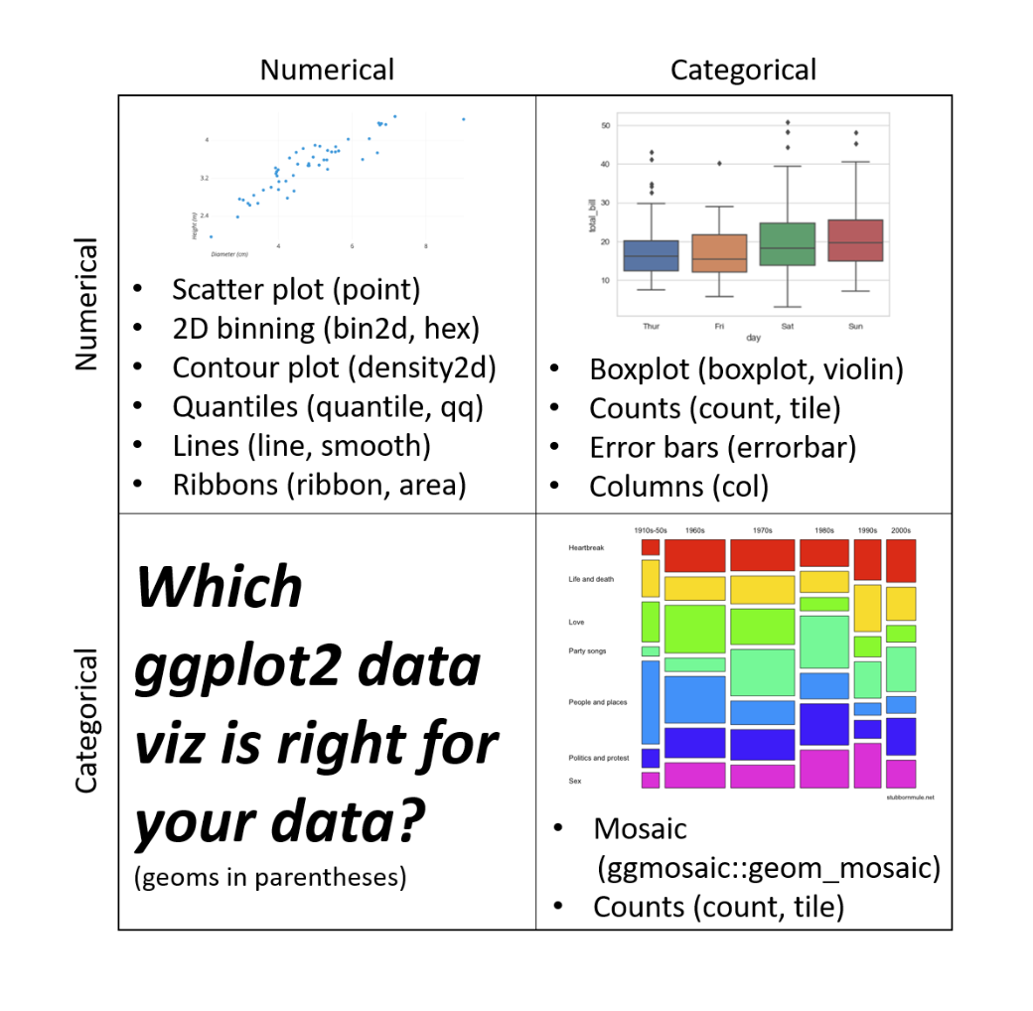
When visualising
2 variables
From Dr Sam Tyner’s guest lecture video in Topic 4

Slide 25
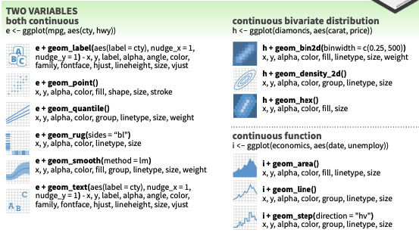
2 variable geoms: numeric
Continuous/numeric X & Y
Line chart
Scatter plot
Etc.

Slide 26
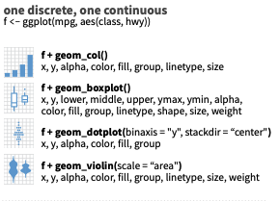
2 variable geoms: numeric & categorical
Continuous/numeric X & Discrete/Categorical Y
Bar chart
Discrete/Categorical X & Continuous/numeric Y
Box plot
Dot plot
Violin chart

Slide 27
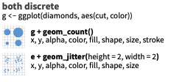
2 variable geoms: categorical
Discrete/categorical X & Y
Mosaic charts
Counts

Slide 28
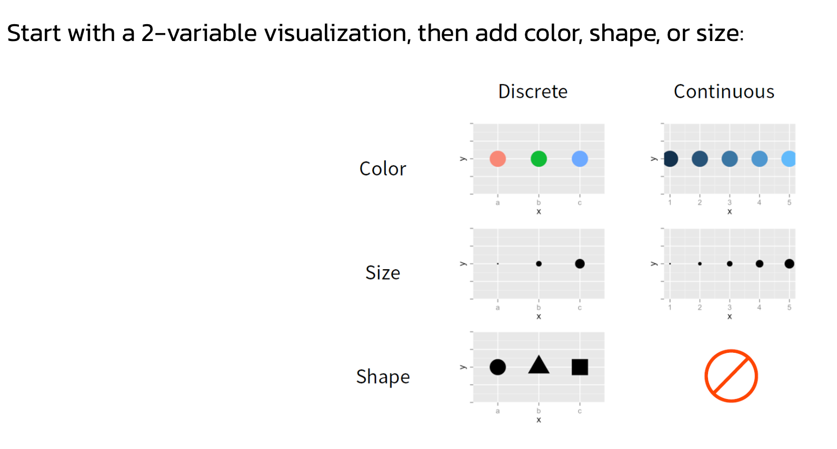
When visualising
3 variables
From Dr Sam Tyner’s guest lecture video in Topic 4

Slide 29
When visualising
3 + variables
Add another variable with Facets
From Dr Sam Tyner’s guest lecture video in Topic 4

Slide 30
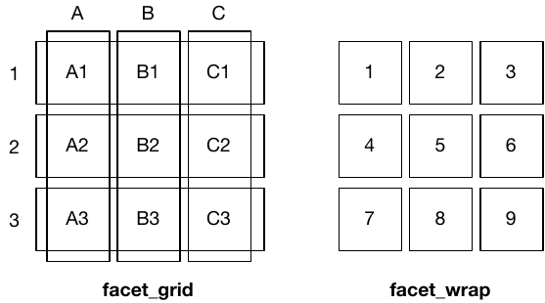
Visualising 3+ variables: Facets
Fundamentally 1 dimensional
Fundamentally 2 dimensional
+facet_grid(row ~ column)
Makes a matrix of panels by row & column faceting variables
+facet_wrap(variable)
Makes a long ribbon of panels

Slide 31
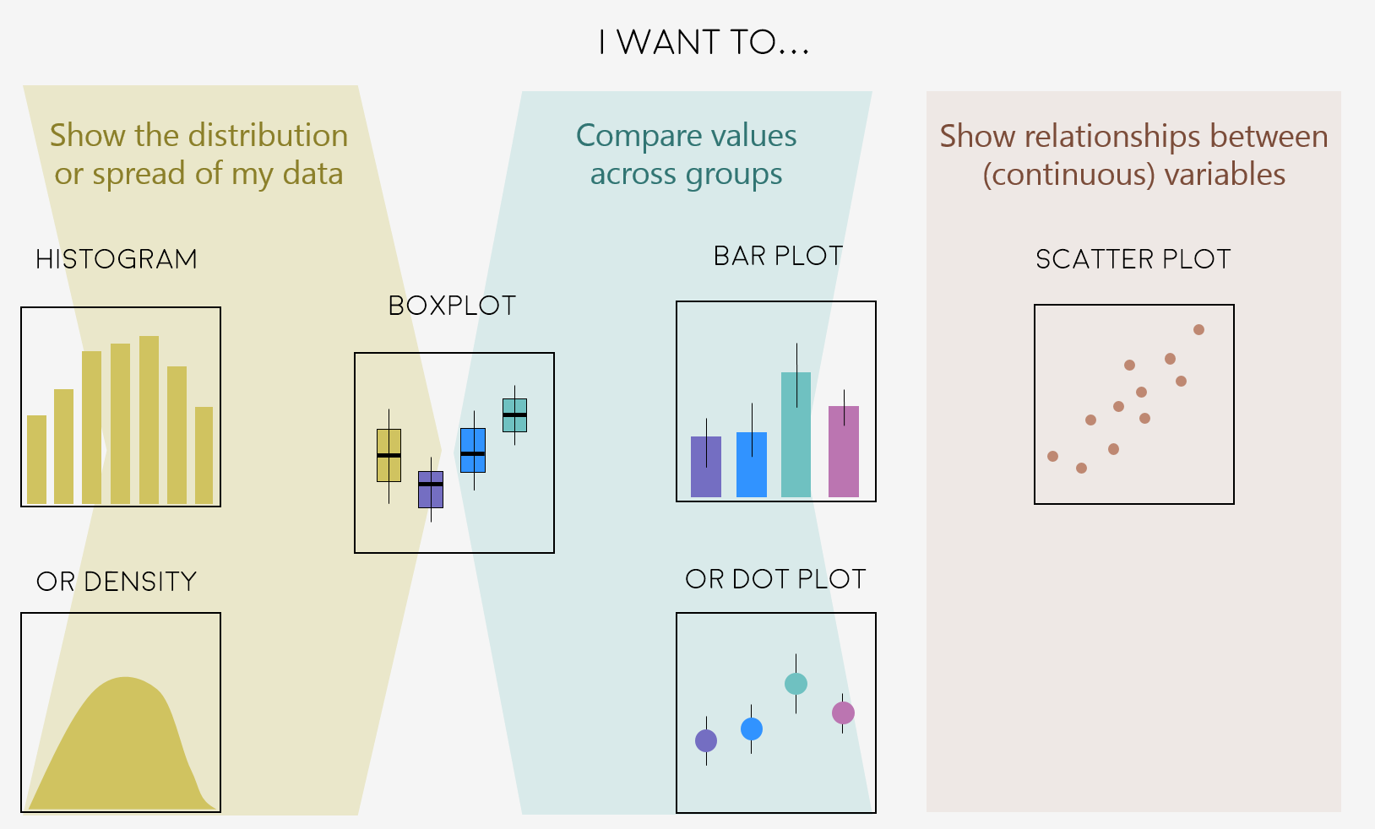
Geoms: decisions, decisions
+ geom_boxplot()
+ geom_jitter()
+ geom_hist()
+ geom_point()
+ geom_col()
+ geom_bar()
+ geom_density()
+ geom_dotplot()

Slide 32
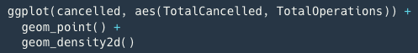
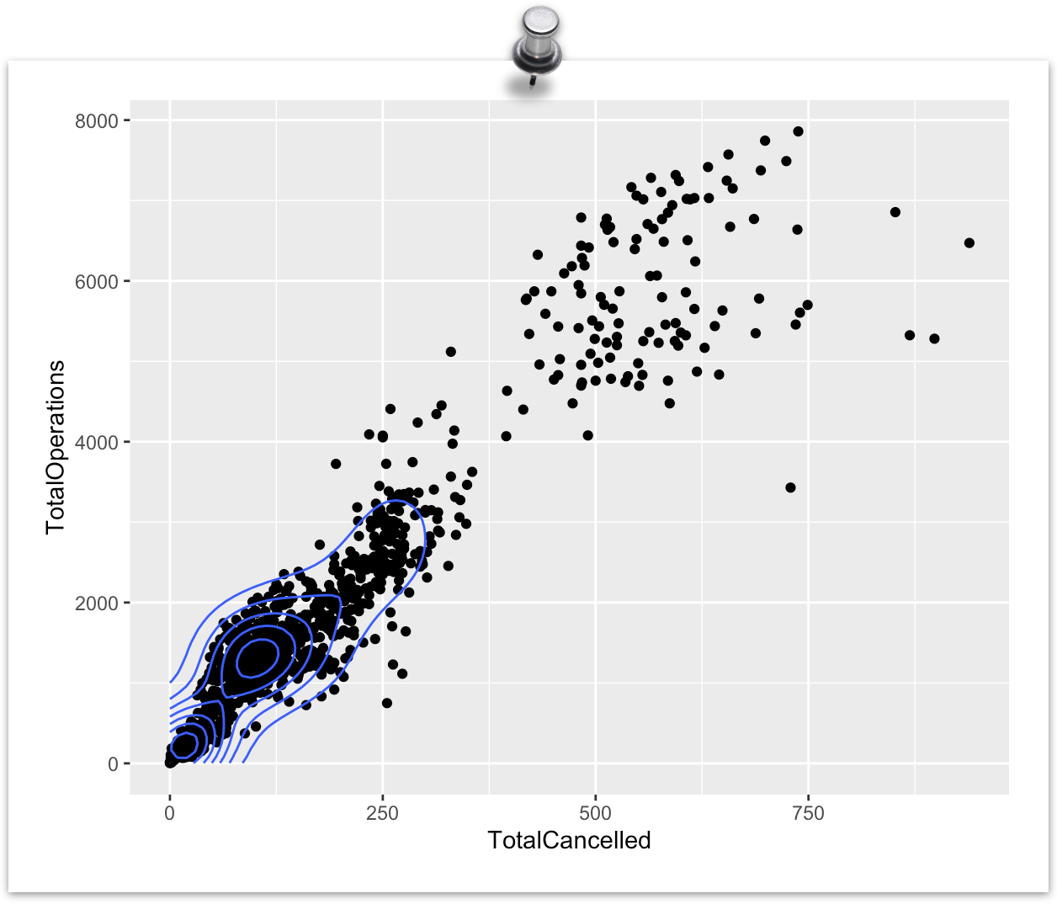
ggplot2 layers
Stacked in order of code appearance
Important to keep in mind as elements written later in your code may hide or overwrite previous elements

Slide 33

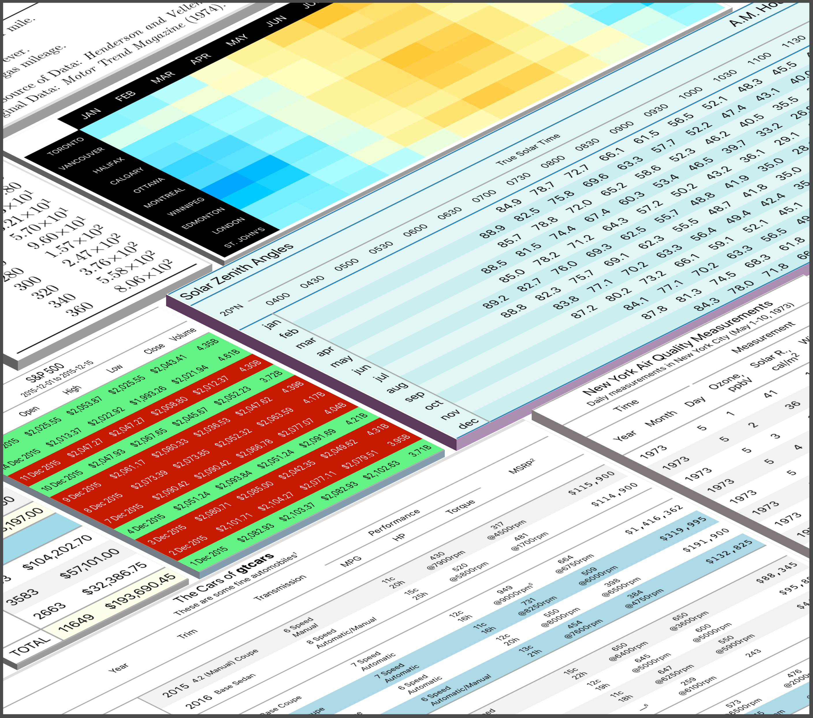
kable and kableExtra
Create Awesome HTML Table with knitr::kable and kableExtra
Pipe wrangled data to %>% kbl()

Slide 34
To Rstudio!

Slide 35
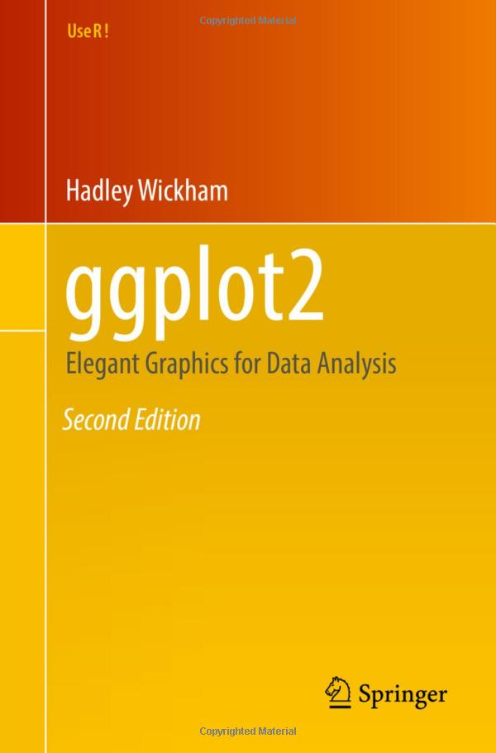
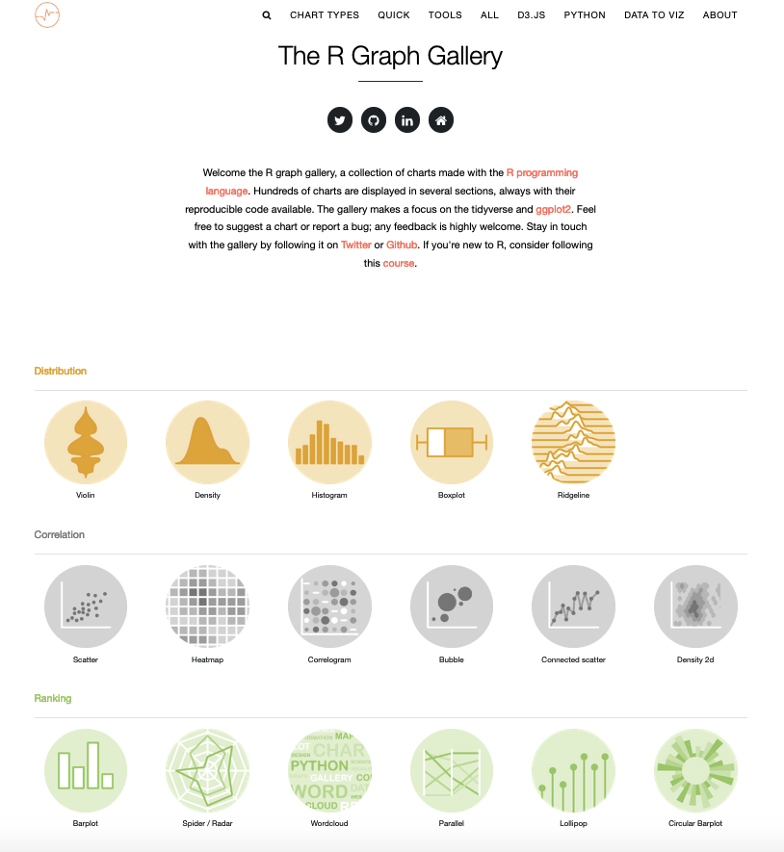
Further Resources
(free!) ggplot2 book
R Graph Gallery

Slide 36
Questions?

